Slide 1
Portfolio Website
By Derrick Lai

Slide 2
Outline
Sitemap
Design concept
Components used
Moving forward

Slide 3
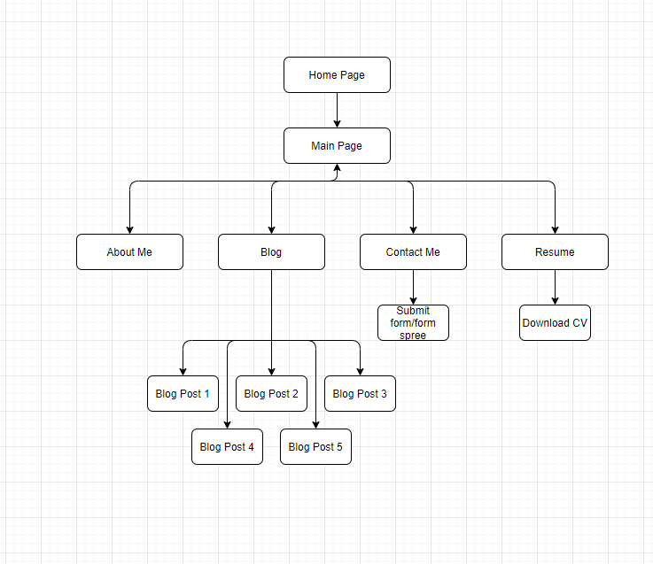
Site map

Slide 4
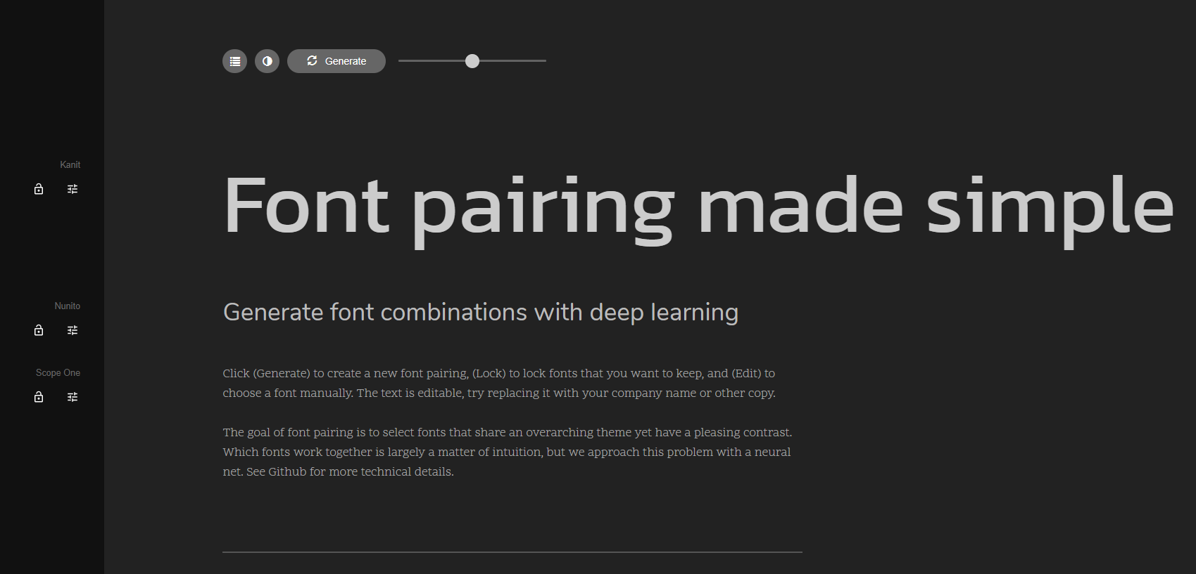
Design concept
Generated 3 font types using fontjoy:
Kanit
Nunito
Scope One

Slide 5
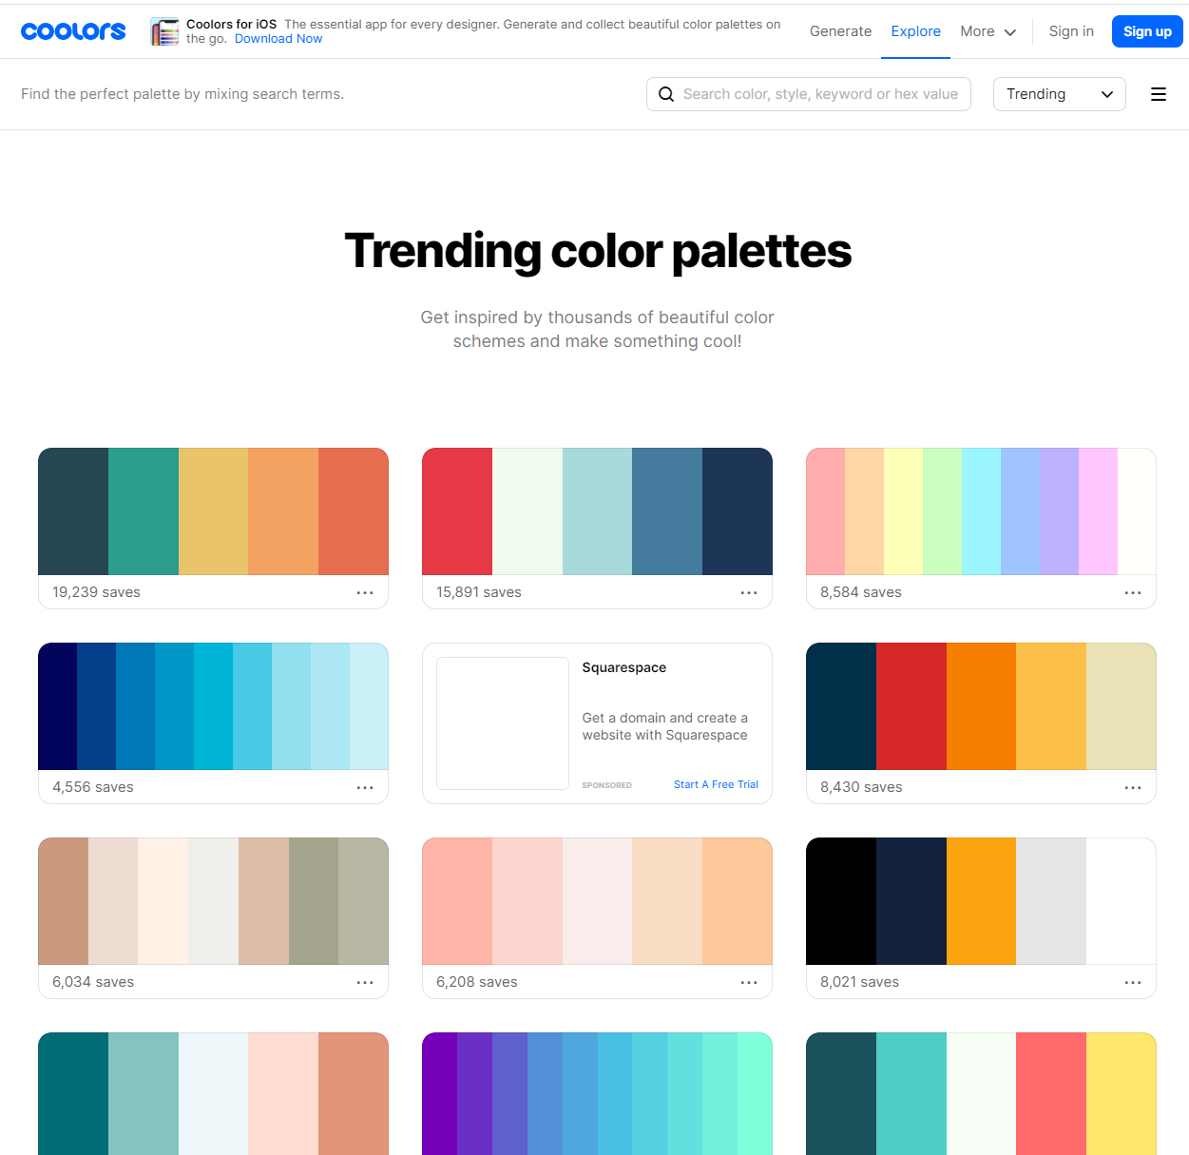
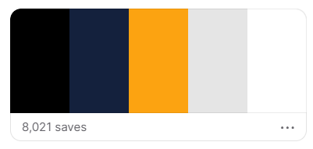
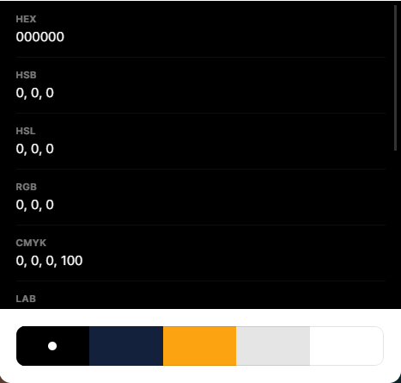
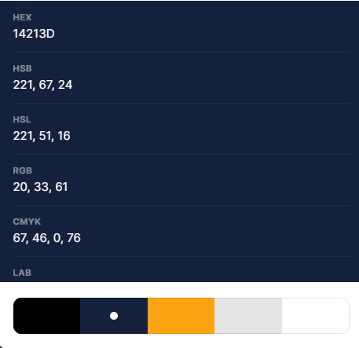
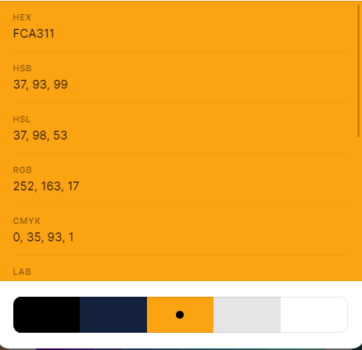
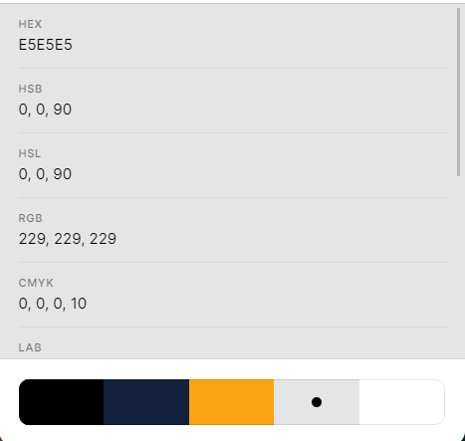
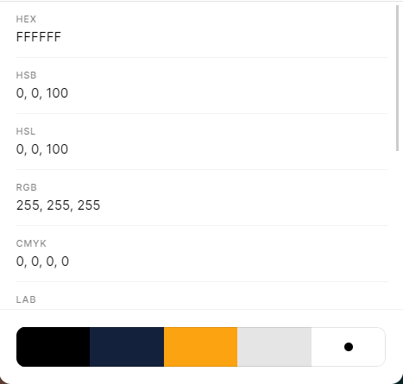
Design concept
Browsing coolors.co for colour inspirations.

Slide 6
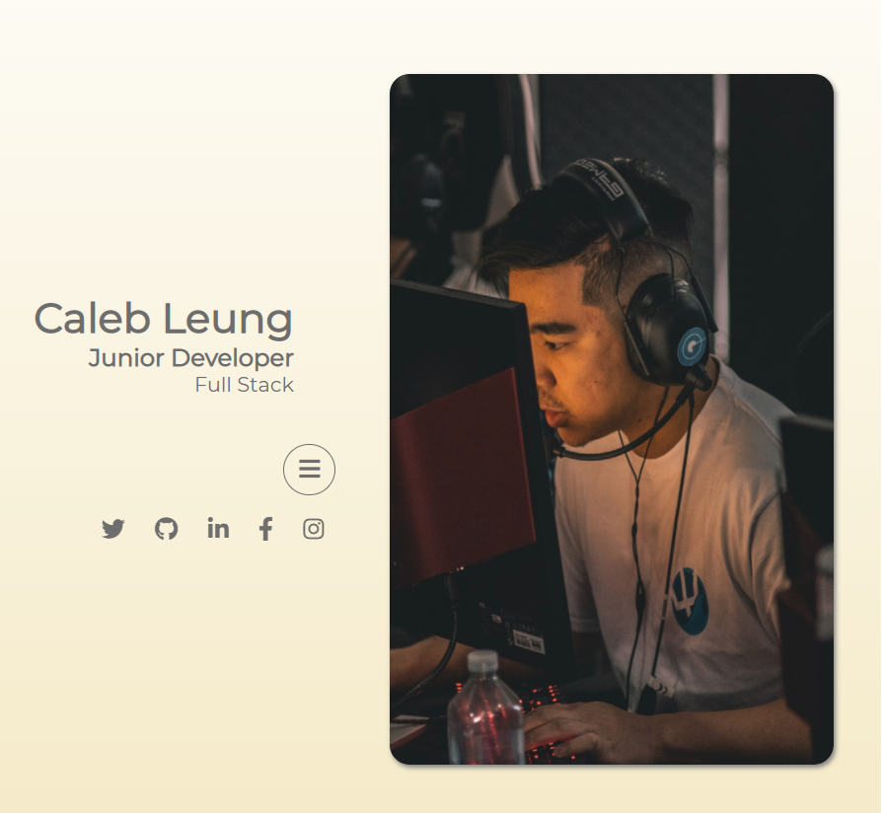
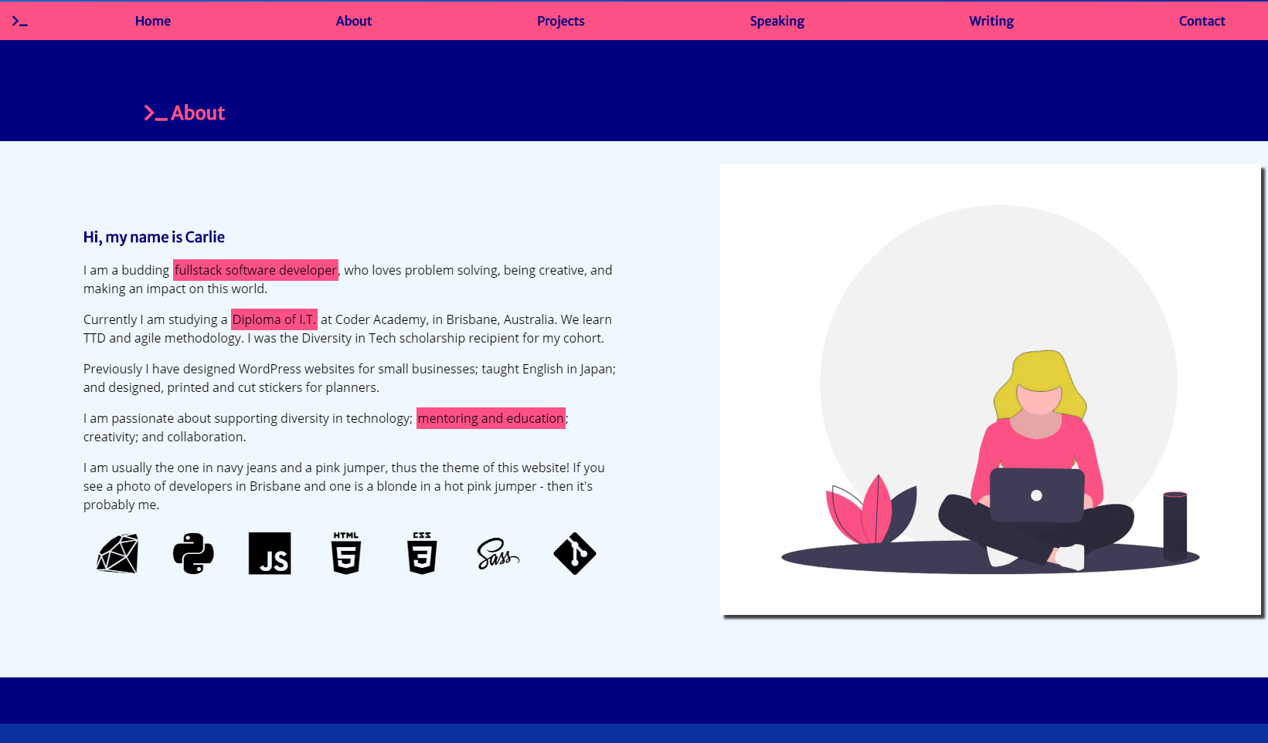

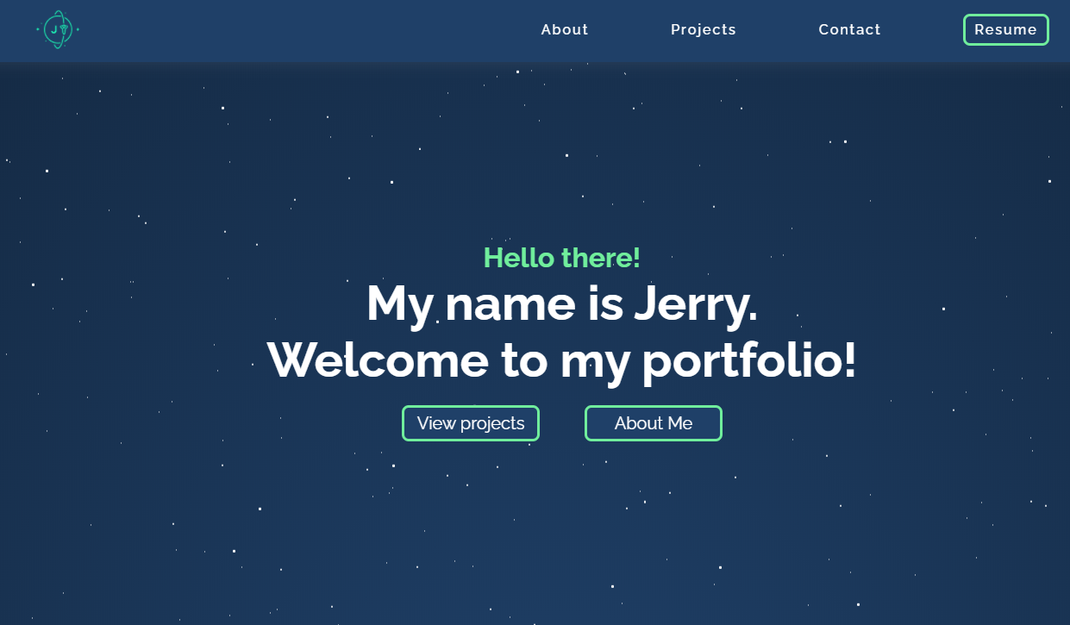

Design concept
Inspirations

Slide 7
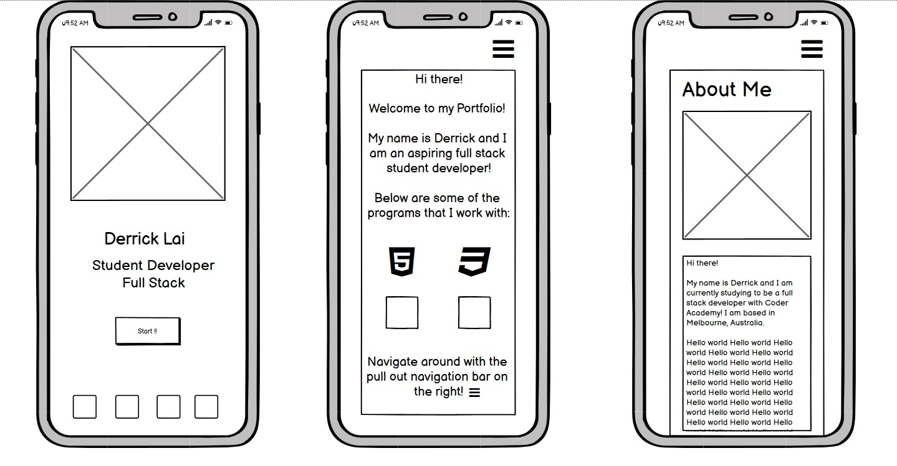
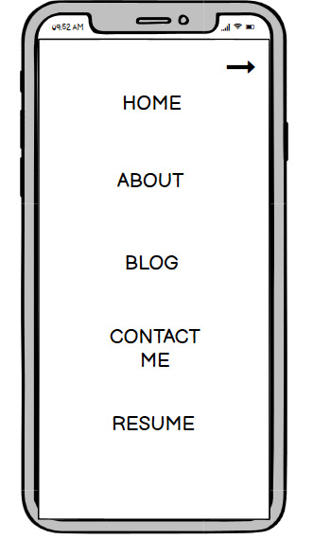

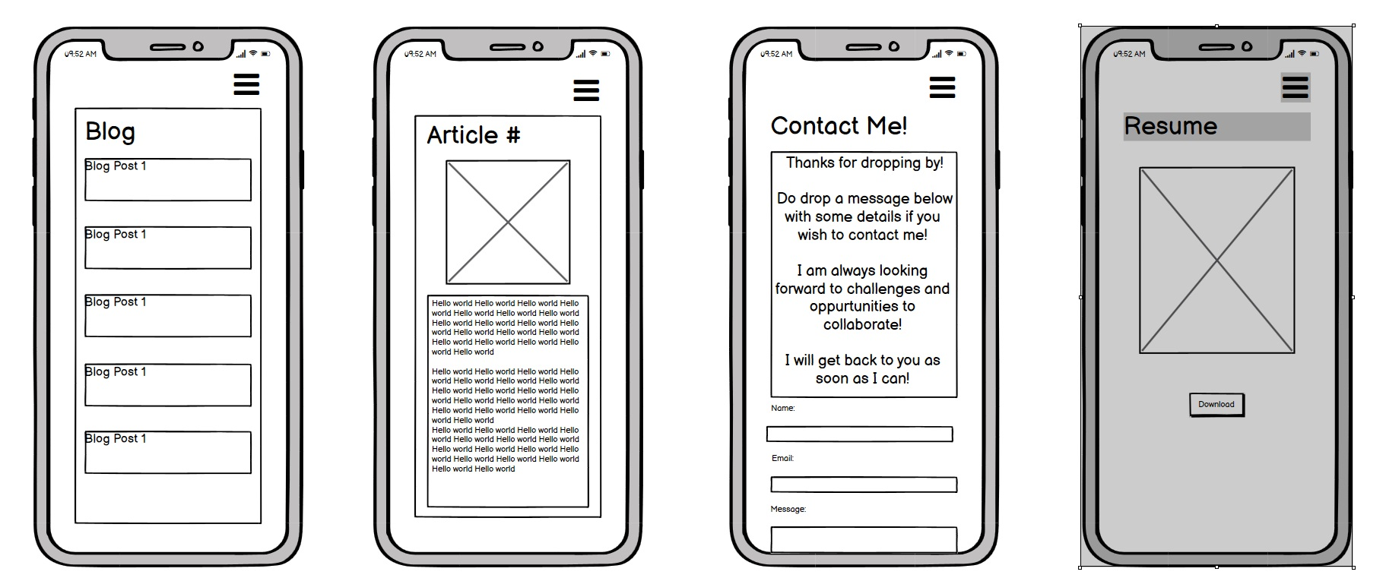
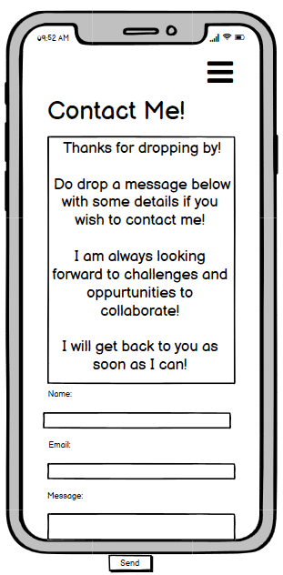
Wireframe (mobile)

Slide 8
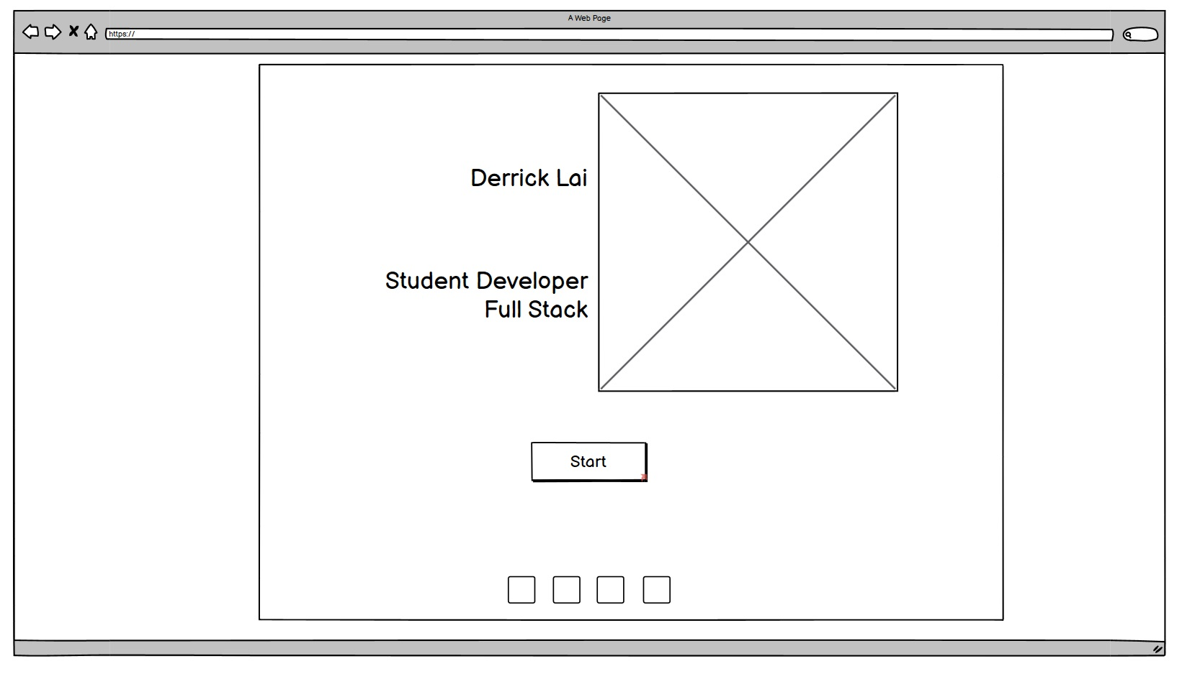
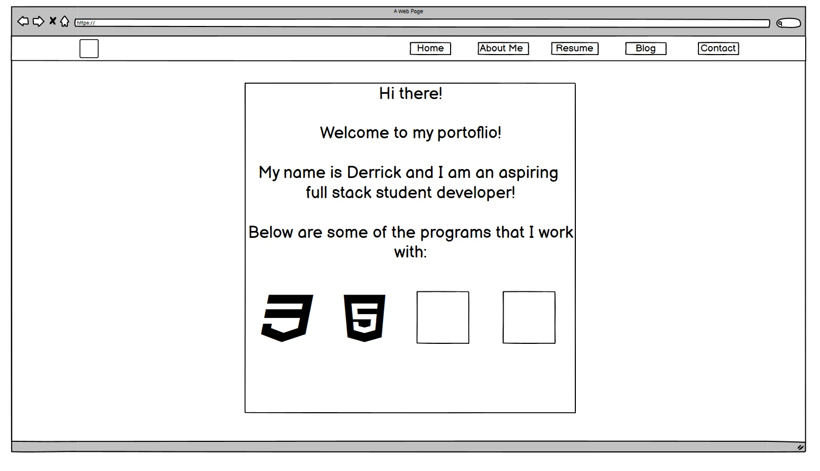
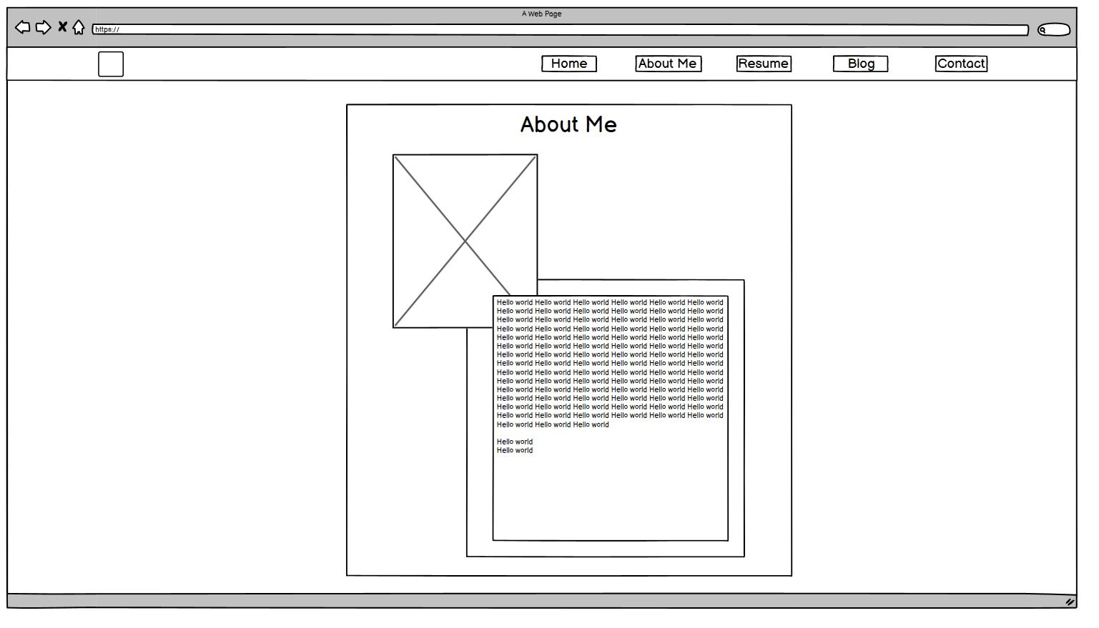
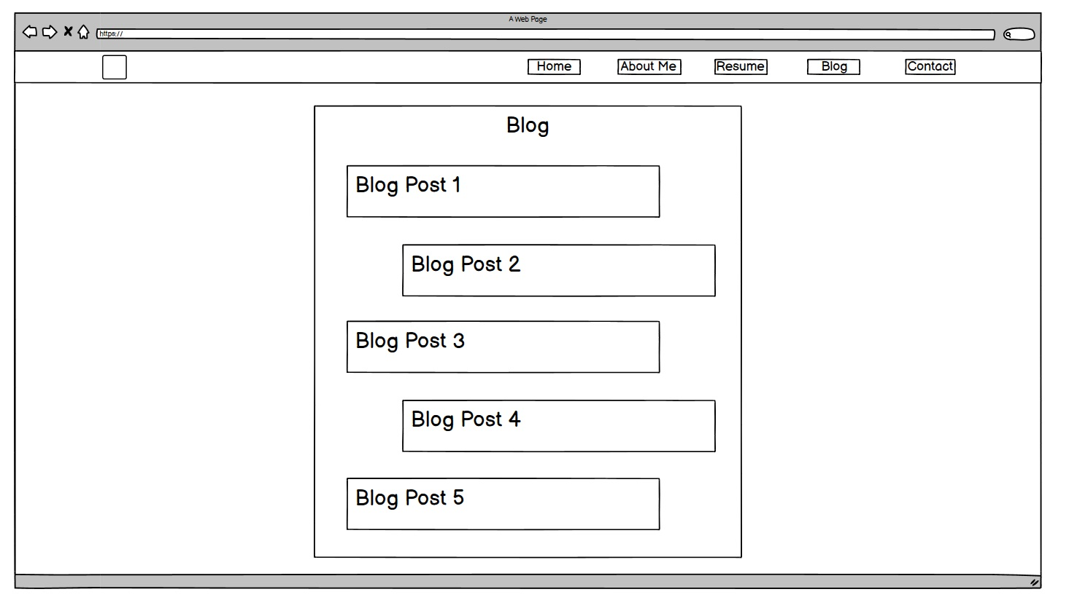
Wireframe (browser)

Slide 9
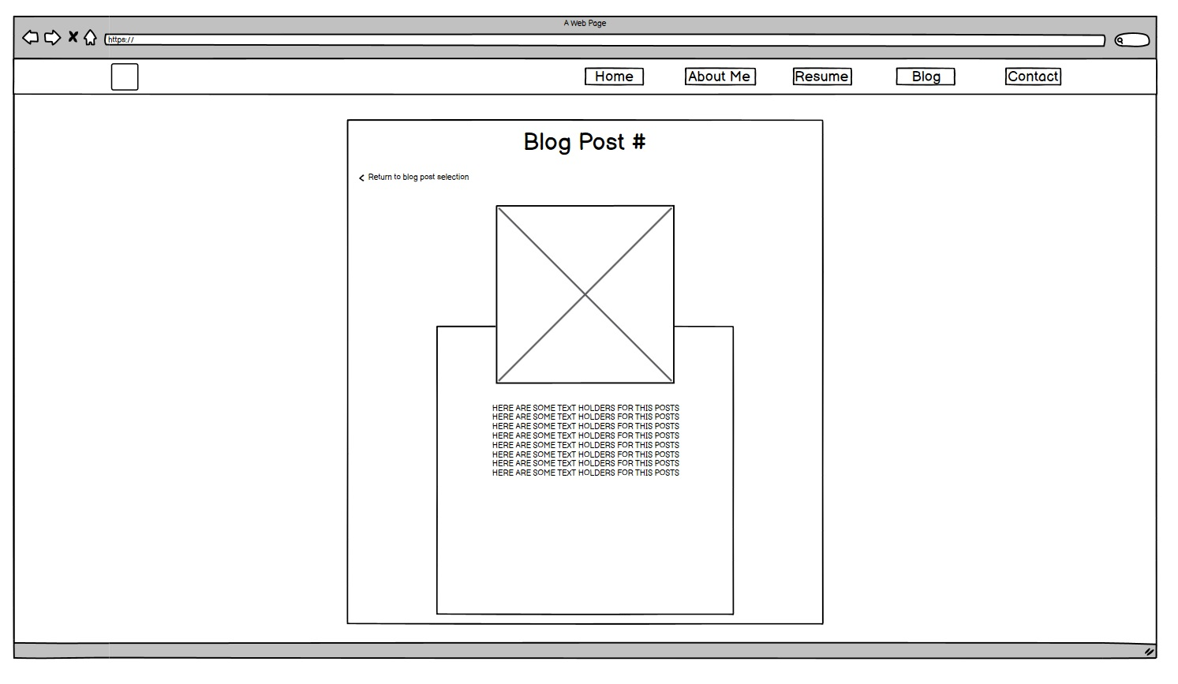
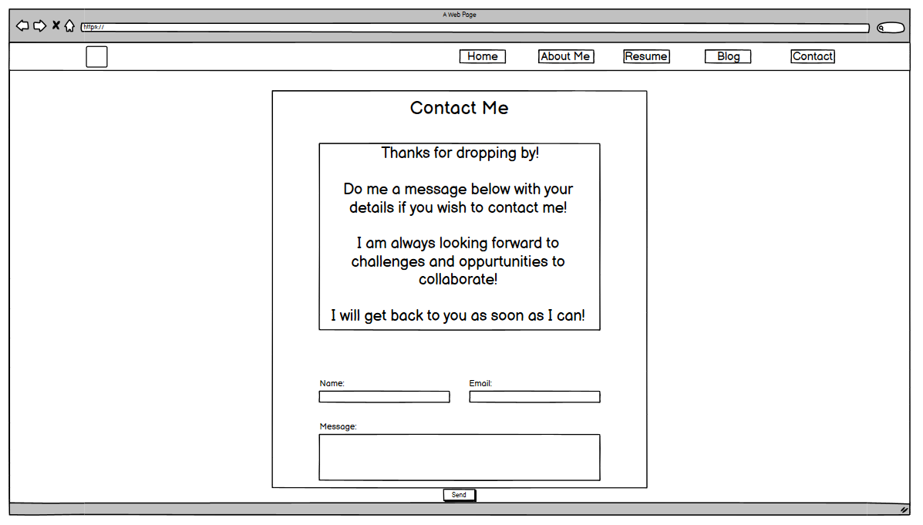
Wireframe (browser)

Slide 10
Components used
Side navbar in mobile, top navbar in browser
Animated “Start” button
Containers/Box for aligning and displaying contents
Cards for blog posts design
Submit message button using formspree
Download button for CV
Flexbox

Slide 11
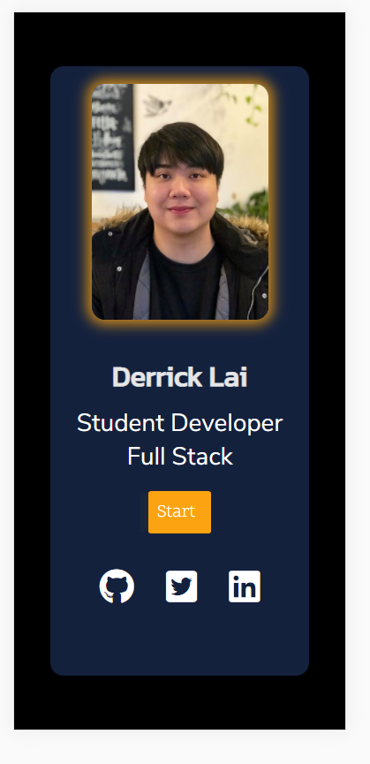
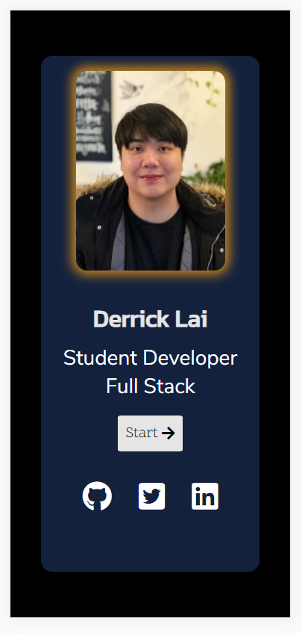
Site Progress

Slide 12


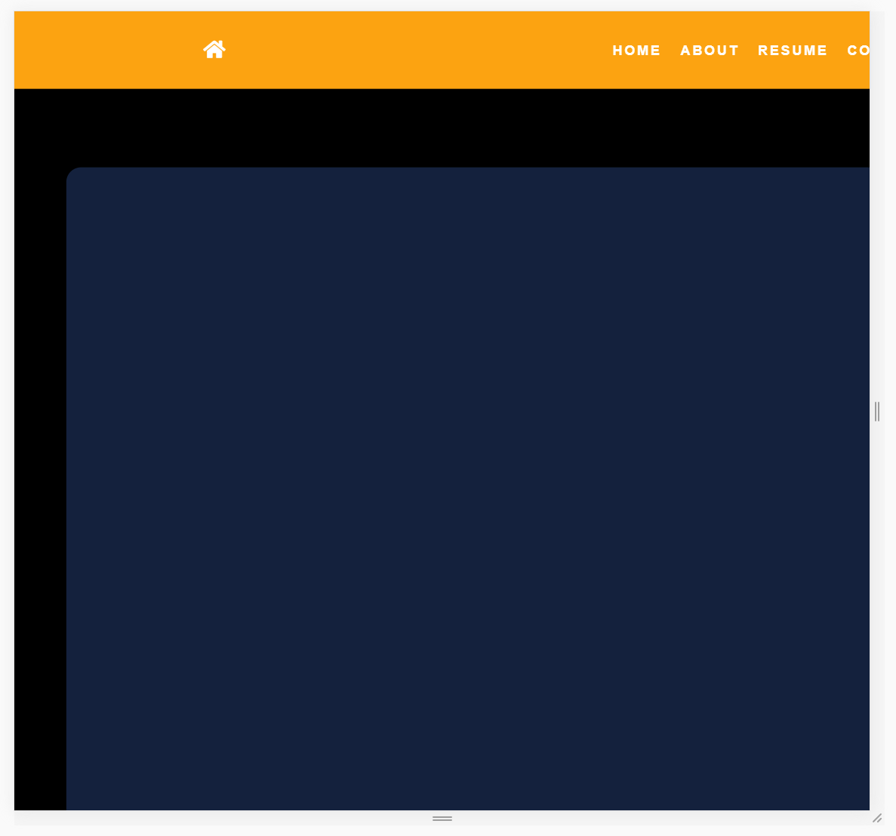
Site Progress
Challenges:
Solving the overflow problem and balancing the viewport not working correctly.
@media query for both mobile and browser (possibly to accommodate tablets)

Slide 13
Moving Forward

